Slide 1
SIMPLIFYING THE BRAIN: A Vision for Neuroscience Research
V. Srinivasa Chakravarthy
Department of Biotechnology
IIT Madras.

Slide 2


“The number of neurons in the Brain are…
more than the number of stars in the Milkyway Galaxy.”

Slide 3


“The Brain is the most COMPLEX object in the Universe.”

Slide 4

Why the HYPE?

Slide 5



1. Large Projects

Slide 6
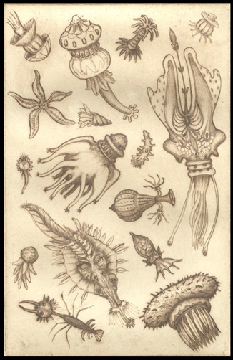
2. Descriptive tradition of Biology
Antoine von
Leeuwenhoek’s
Drawings of
“animalcules”

Slide 7

Can a biologist fix a radio?
Yuri Lazebnik, Can a biologist fix a radio?—Or, what I learned while studying apoptosis
Cancer Cell, 2012.

Slide 8
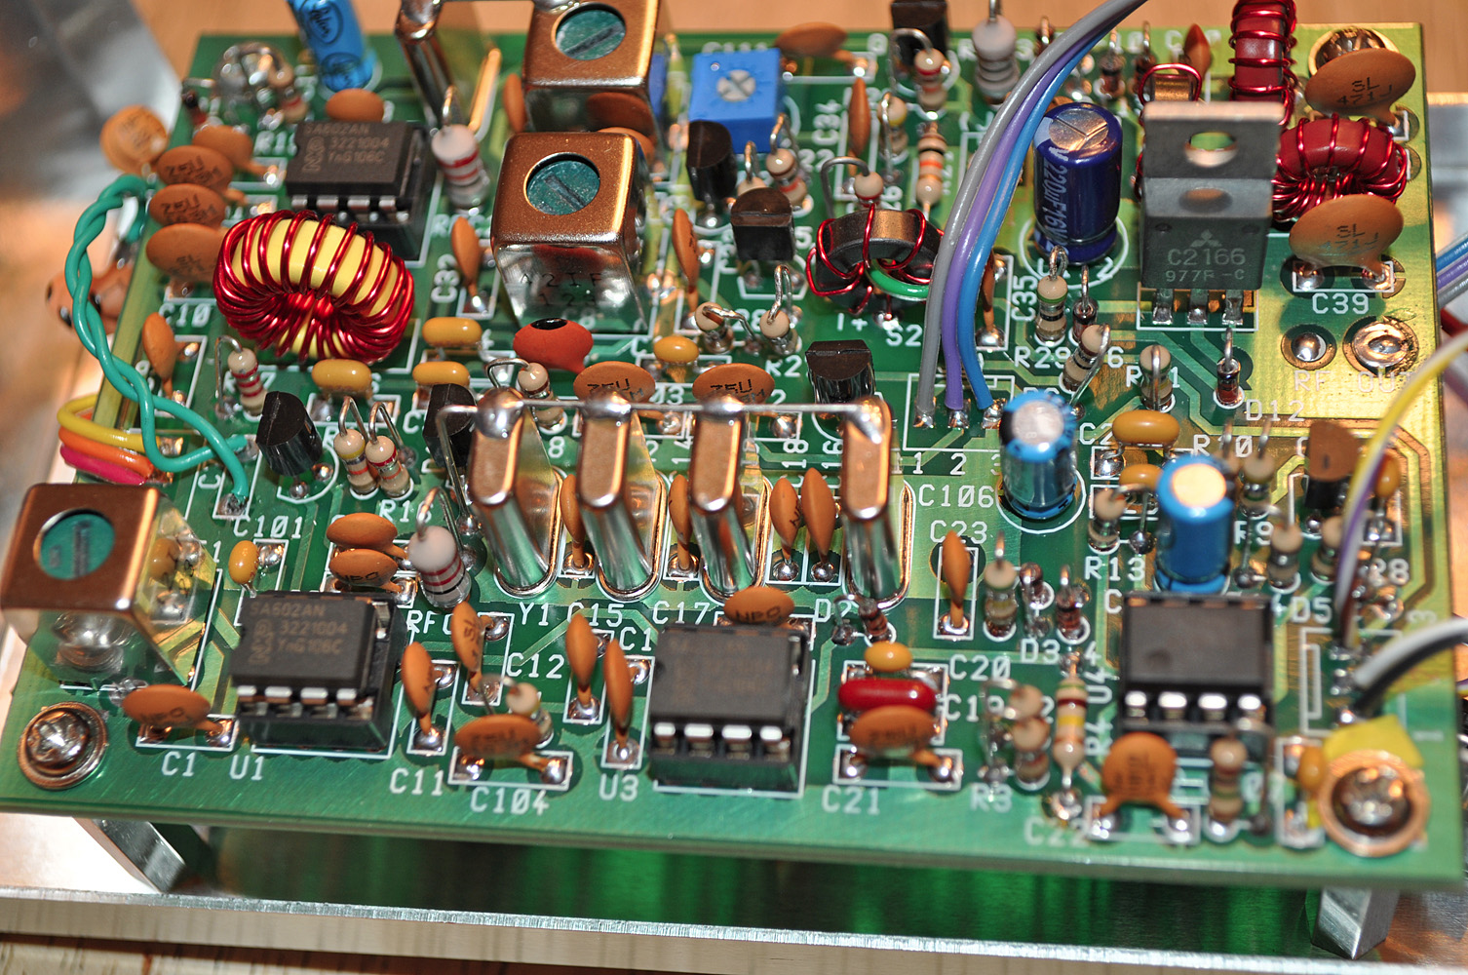

Slide 9


Architecture of a Radio
Tuner
Circuit
Demodulator
Amplifier
Antenna
Speaker

Slide 10

3. Big data …

Slide 11
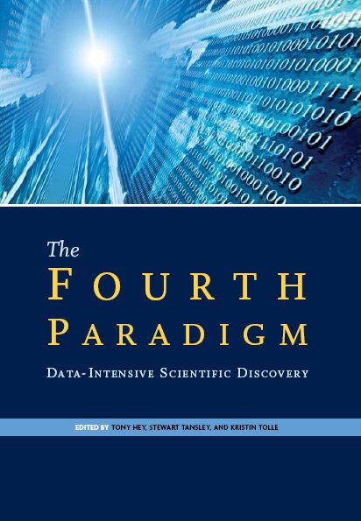
DATA in modern world
Data as the fourth pillar of science
The first 3 pillars are:
Theory
Experiment
Computation

Slide 12
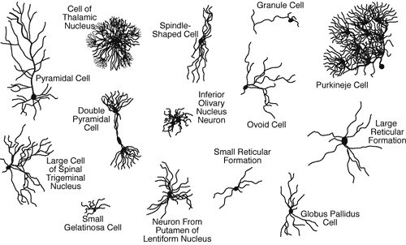
Neurons come in different Shapes

Slide 13
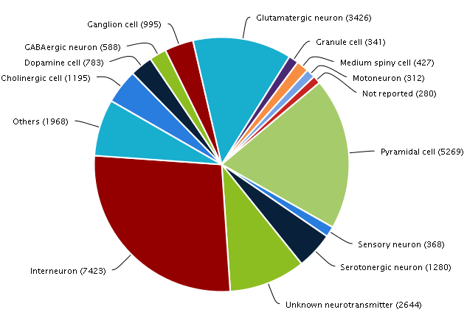
Neuromorph

Slide 14
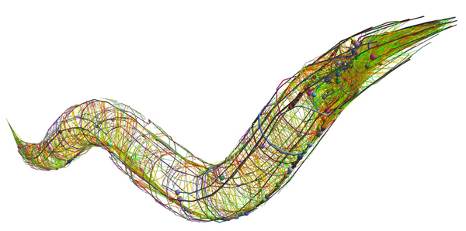

The Connectome Project
To find out the complete wiring diagram of the brain
Human brain
Has 100 billion neurons
Each neuron has about 1k-10k connections
Feasible for smaller organisms
C. Elegans connectome – 300 neurons, 7000 connections (White et al 1986)

Slide 15
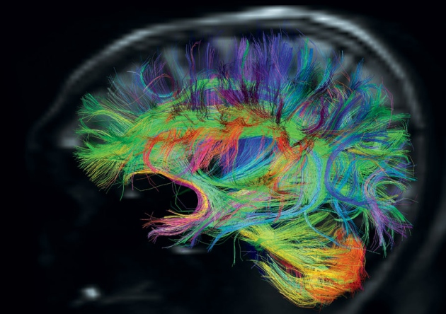
Human Connectome Project
- 1200 individuals
- fMRI + dMRI +
+ MRI + MEG
Washington U +
U. Minnesota
http://www.humanconnectome.org/

Slide 16
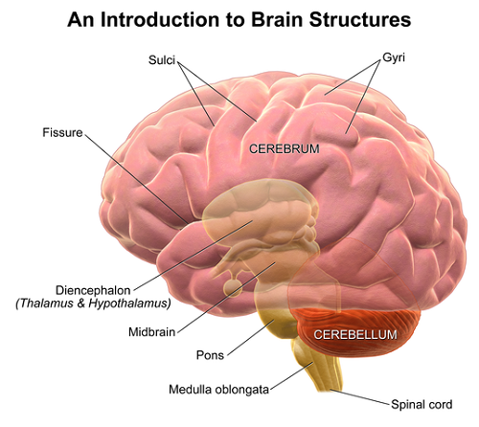
Why Connectome?
We don’t even know why:
There are two cerebral hemispheres?
There is a cortex?
Why the cerebellum is outside and thalamus inside?
What is the hurry
for the Connectome?

Slide 17
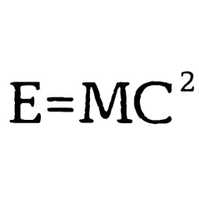
4. Big data …and tiny theory

Slide 18
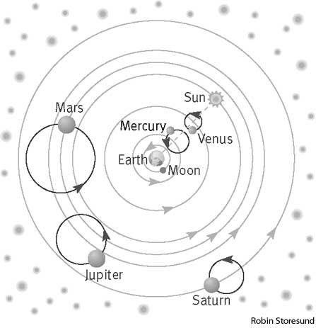
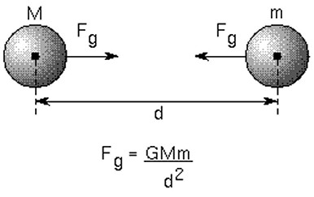
Analogy from the History of Astronomy
Ptolemaic Astronomy
Newtonian Astronomy

Slide 19
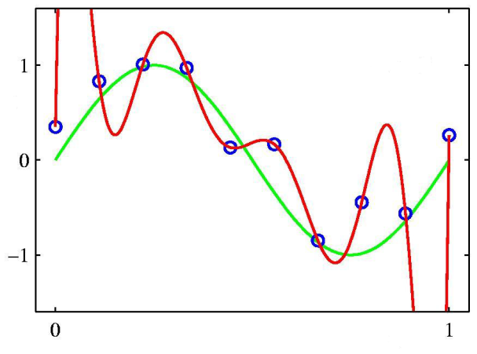
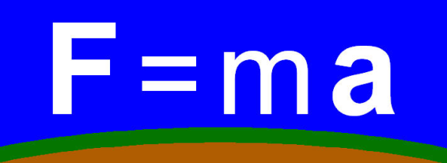
The Problem with Computational Modeling
More biology-style modeling
A thin wrapper over data
Less physics-style modeling
Need deep integrative theories
that relate diverse phenomena

Slide 20



Neuroscience is … theory weak
No satisfactory, comprehensive theory for most key brain structures
Verbal, hand-waving theories.
Thalamus is a relay station
Basal ganglia is a comparator
Neuroscience is… “data rich but theory poor.”
“We are at Faraday stage in neuroscience.”
VS Ramachandran
(Neuroscientist)
Patricia Churchland
(Neuroscientist)
Terry Sejnowski
(Neuroscientist)

Slide 21

4. The Problem of Reductionism
Systems
Neurons
Molecules
The futile attempt to explain everything in terms of molecules and cells.

Slide 22
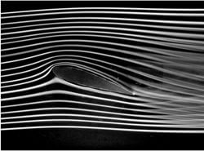
Engineering doesn’t work that way
Example:
Aircraft wing in a wind tunnel
Study fluid flow using Navier-Stokes Equation
FLUID is an abstraction
FLUID is NOT molecules

Slide 23
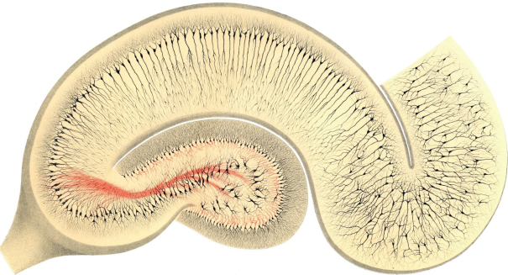
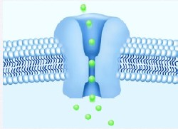
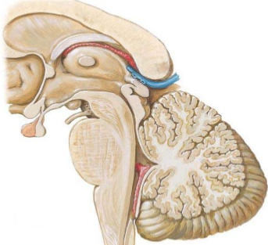
And therefore there is… Disproportionate Development
Rigorous understanding at
cell and molecular level
Inadequate understanding at
Systems Level

Slide 24

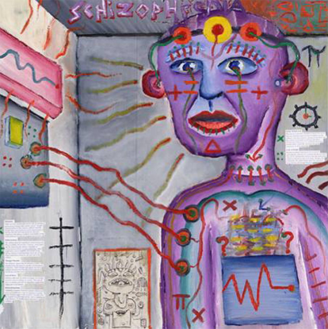
Lack of good theories of Multifactorial Diseases
Bipolar disorder
Schizophrenia

Slide 25


Contemporary Neuroscience
Basic Neuroscience
Clinical Neuroscience

Slide 26

Sometimes treatments work in mysterious ways!

Slide 27
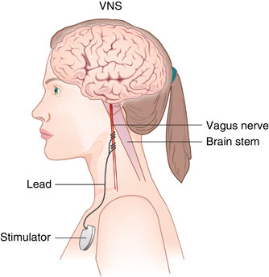
Vagal stimulation
For:
Epilepsy
Major Depressive Disorder
Adverse effects:
Nausea to cardiac arrest
Mechanism:
“As of 2017 little was understood about exactly how vagal nerve stimulation modulates mood and seizure control.” (Wiki) (Edwards et al 2017)
Image courtesy: https://www.researchgate.net/publication/51696122_Somatic_Treatments_for_Mood_Disorders

Slide 28
Lithium for Bipolar Disorder
Preferred treatment for 70 years
Reduces severity of mania
Helps prevent depression in Bipolar disorder
Reduces suicide risk
“Exactly how lithium works to do this is not known, though.”
https://www.healthline.com/health/bipolar-disorder/lithium-use-bipolar#about-lithium

Slide 29

Prescriptions for the mind
“[By around 1972] psychiatrists had a useful armamentarium of drugs, falling into four groups: antipsychotics for schizophrenia, tricyclic antidepressants for depression, lithium for mania, and benzodiazepines for anxiety and insomnia. With these agents, we could help many, if not most, of our sickest patients.”
Pg 113

Slide 30
Prescriptions for the mind
“One should also keep in mind that we do not know how most of the drugs used for mental disorders work.
“It is entirely possible, however, that advances in neurosciences may lead to further breakthroughs in pharmacotherapy.”
Pg 113

Slide 31
Living with a Broken Brain

Slide 32

A stroke patient’s caregiver
https://elements.envato.com/partial-view-of-senior-woman-carrying-husband-in-w-U5QNAC5

Slide 33

https://www.dreamstime.com/illustration/mental-retardation.html

Slide 34
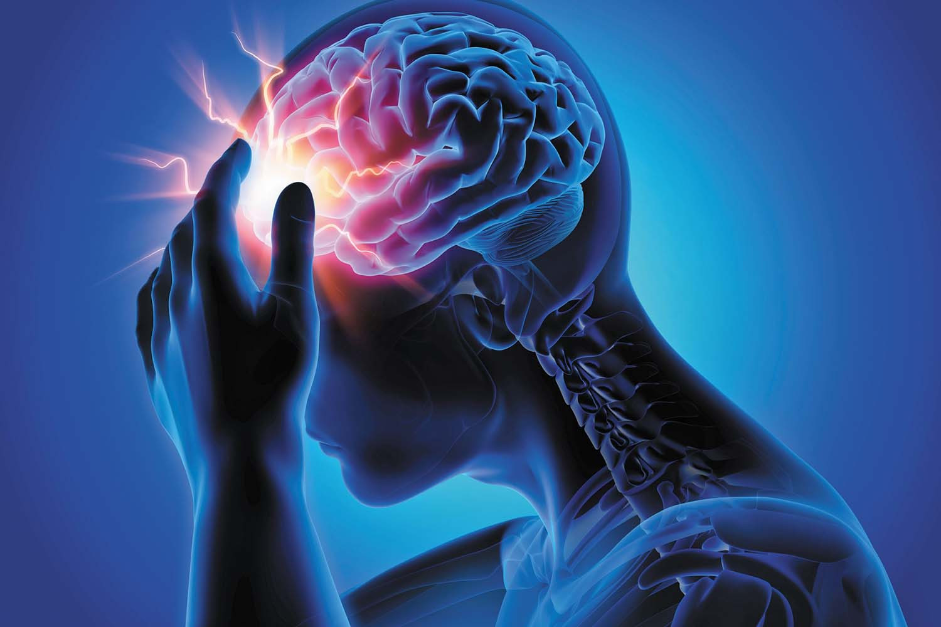
Traumatic Brain Injury
https://sigelmanassociates.com/different-types-traumatic-brain-injury/

Slide 35

The Way Forward?
Breakthroughs in
Brain Theory

Slide 36

There is a need to develop simplified models, embodying the right abstraction, the way it is done in physics and engineering

Slide 37
NEUROSCIENCE EDUCATION

Slide 38

“Principles first” Approach
PRINCIPLES
DETAILS
DETAILS
DETAILS

Slide 39
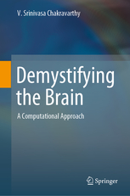

Slide 40
To
Medicine/Biology
Community.
Without math
To
Engineers/
Physicists
Without
Biology jargon

Slide 41
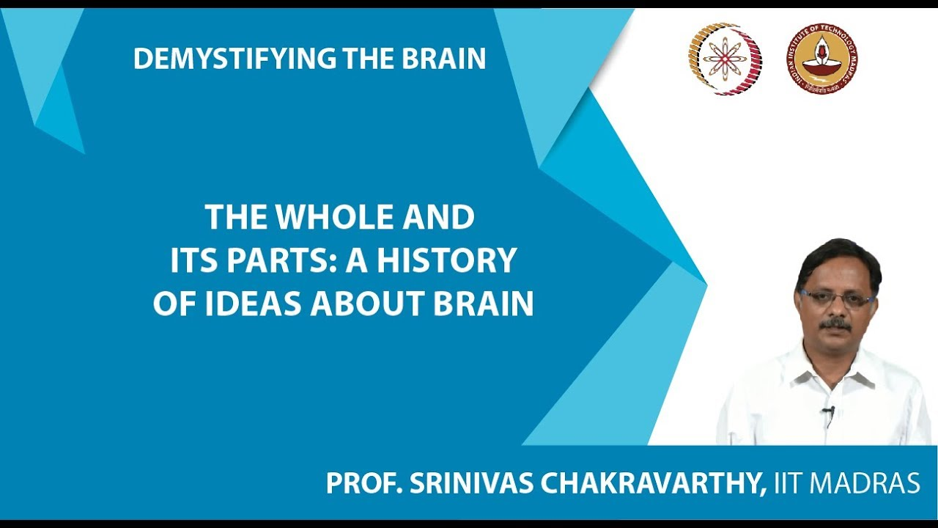
NPTEL COURSE DEMYSTIFYING THE BRAIN

Slide 42
AN APPROACH TO BRAIN modelLiNG
NEUROSCIENCE RESEARCH
SIMPLIFY - UNIFY - APPLY

Slide 43
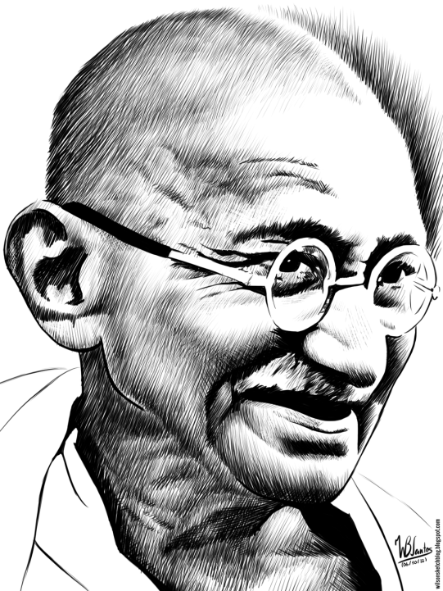

SIMPLIFY: Simplify the model to the point that any further
simplification will make the model absurd.

Slide 44





2. UNIFY: Explain a wide range of experimental data
using the same model

Slide 45
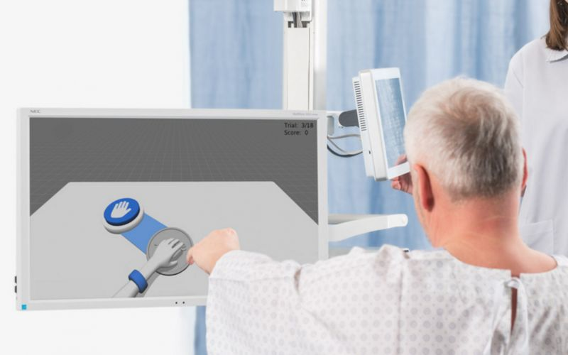

3. APPLY: Using the unified model develop applications in…
CLINICAL NEUROSCIENCE
ENGINEERING

Slide 46
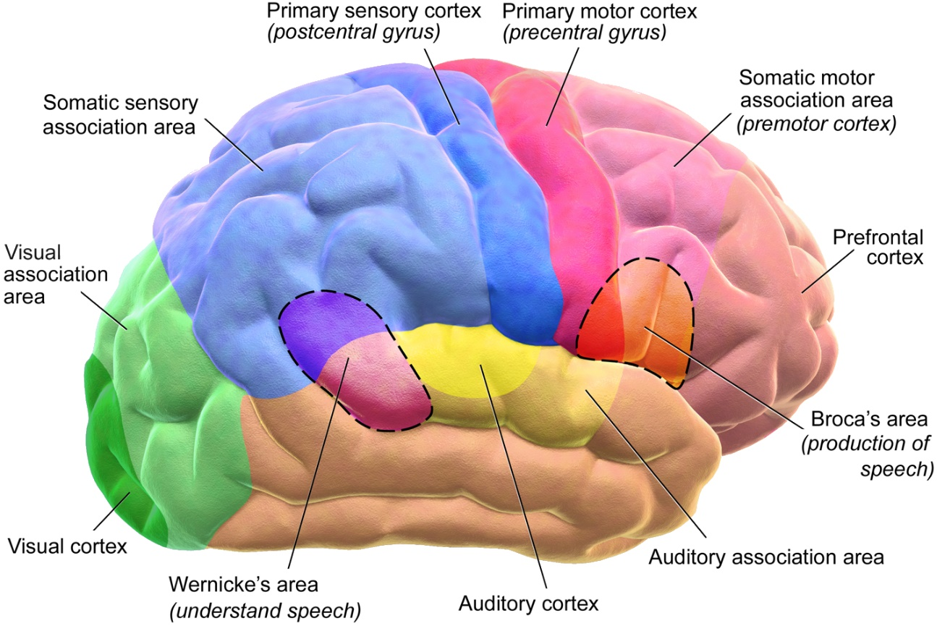
Modeling the Whole Brain
Adult human brain: 100 billion neurons
Proposed model: 10 million neurons (approx)
(Wiki)

Slide 47
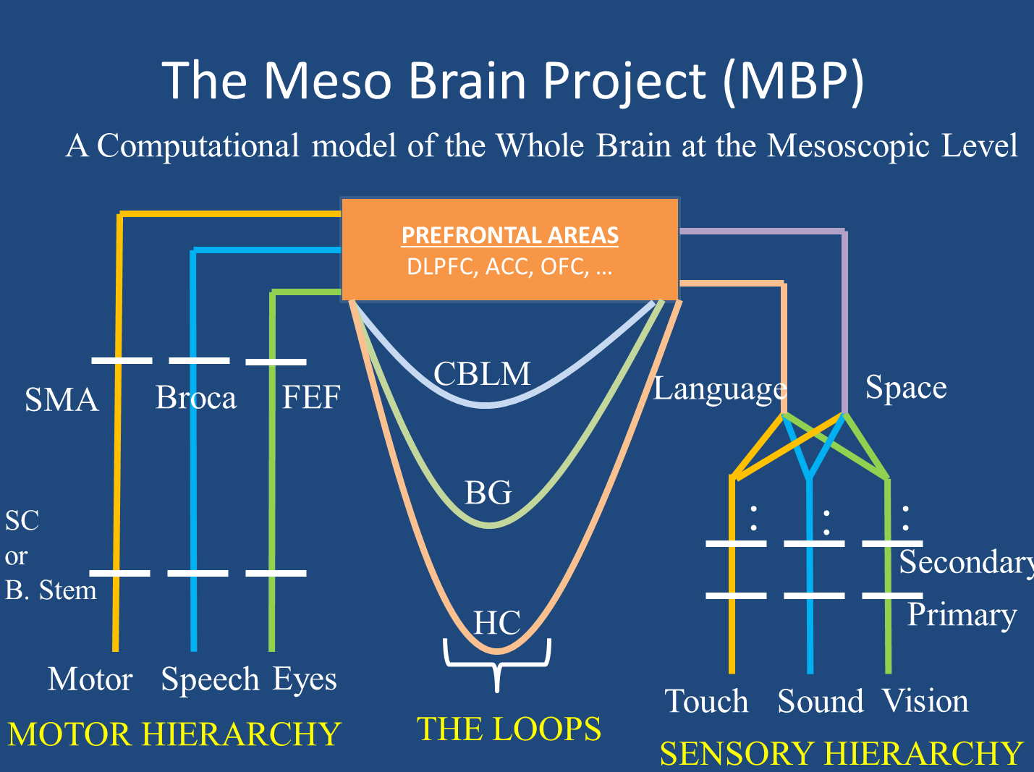

Slide 48
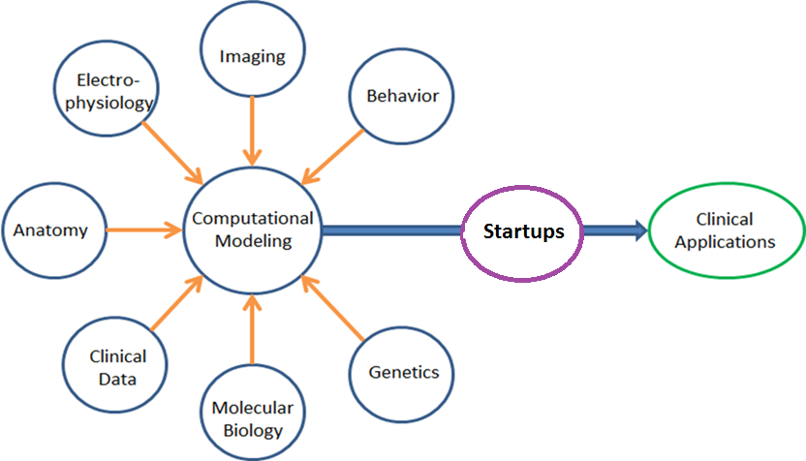
INTEGRATED APPROACH
Create interdisciplinary teams that take an ENGINEERING APPROACH To NEUROSCIENCE

Slide 49
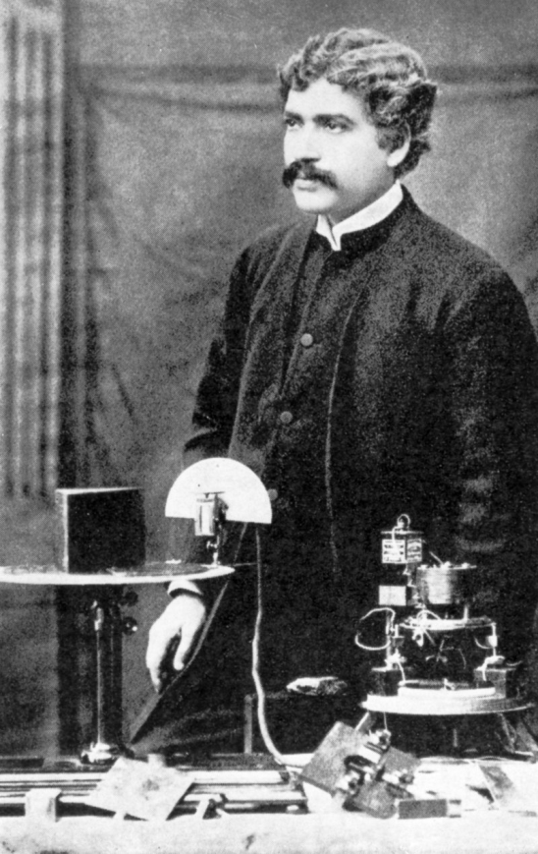
“They who behold the One,
In all the changing manifoldness
Of the universe,
Unto them belongs the eternal truth,
Unto none else, unto none else.”
JAGADIS CHANDRA BOSE
(1858-1937)

Slide 50
Table of Contents
Math preliminaries
Single neuron
Hodgkin-Huxley model
Biophysical modeling
Reduced neuron models

Slide 51
Table of Contents
Feedforward Neural Networks. Deep networks and modeling sensory function.
Oscillatory neural networks
Hopfield neural network. Hippocampus and memory functions.
Self-Organizing Maps and brain maps

Slide 52
Random Research Questions
What is the purpose of sleep? Why are there so many sleep stages?
Why is the cerebellum outside the cerebrum?
The brain tries to regulate the body temperature at about 98.6 F. How is this reference temperature represented?
Need a convincing computational/mathematical explanation for the above questions.

Slide 53
Grading
Midsem – 30 marks
Assignments - 30
Endsem – 40 marks

Slide 54
References
BT6270: NPTEL notes
Steven Strogatz, Nonlinear Dynamics and Chaos
Christof Koch, Biophysics of Computation.
Satish Kumar, Neural Networks
Neuroscience:
Kandel and Schwatz, Principles of Neural Science
VSC, Demystifying the Brain.
Thank you

